Slide 1

Hyperparameter tuning
Tuning process
deeplearning.ai

Slide 2
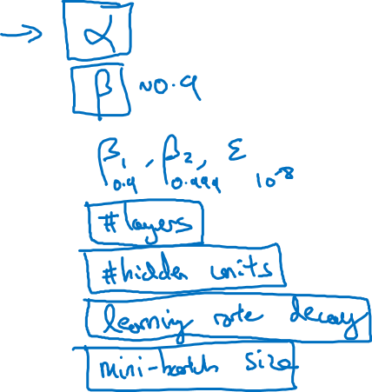
Hyperparameters

Slide 3
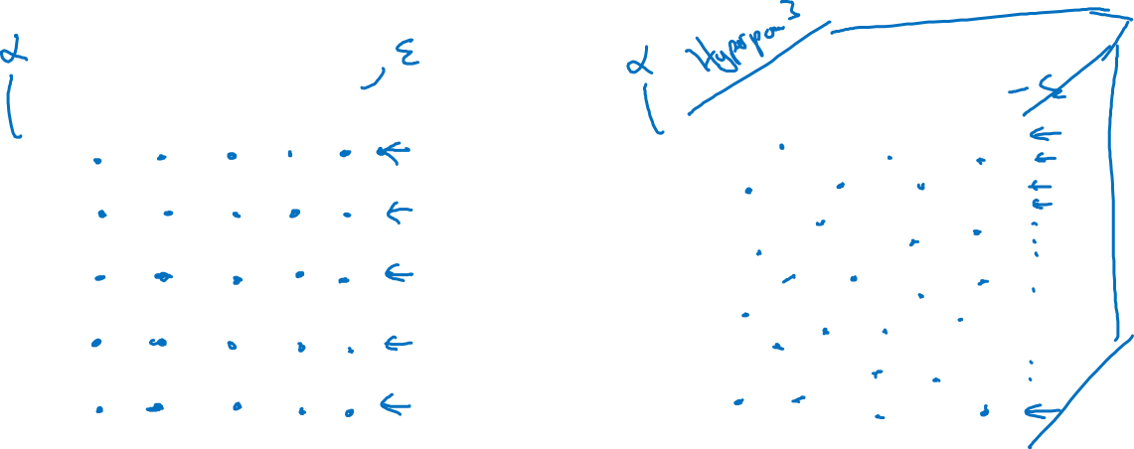
Try random values: Don’t use a grid
Hyperparameter 2
Hyperparameter 2
Hyperparameter 1
Hyperparameter 1

Slide 4
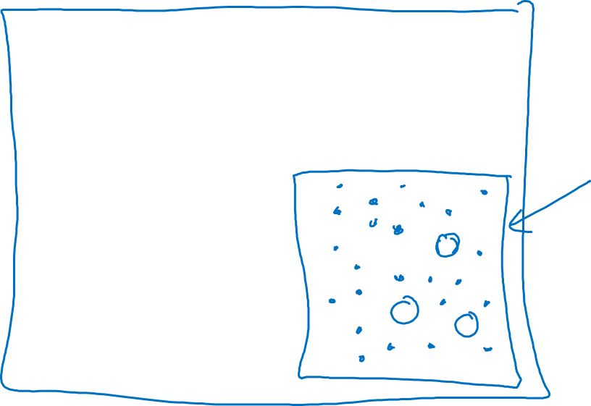
Coarse to fine
Hyperparameter 2
Hyperparameter 1

Slide 5
Hyperparameter tuning
Using an appropriate scale to pick hyperparameters
deeplearning.ai

Slide 6
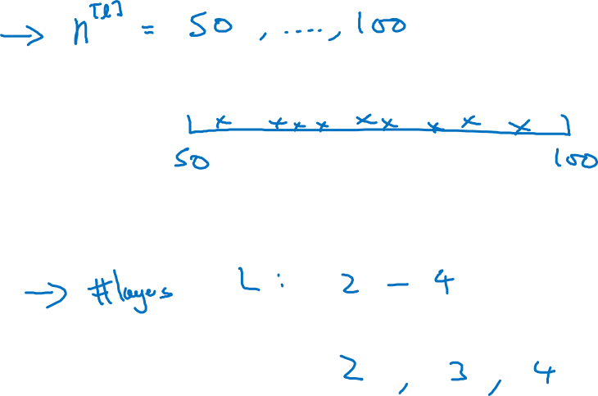
Picking hyperparameters at random

Slide 7
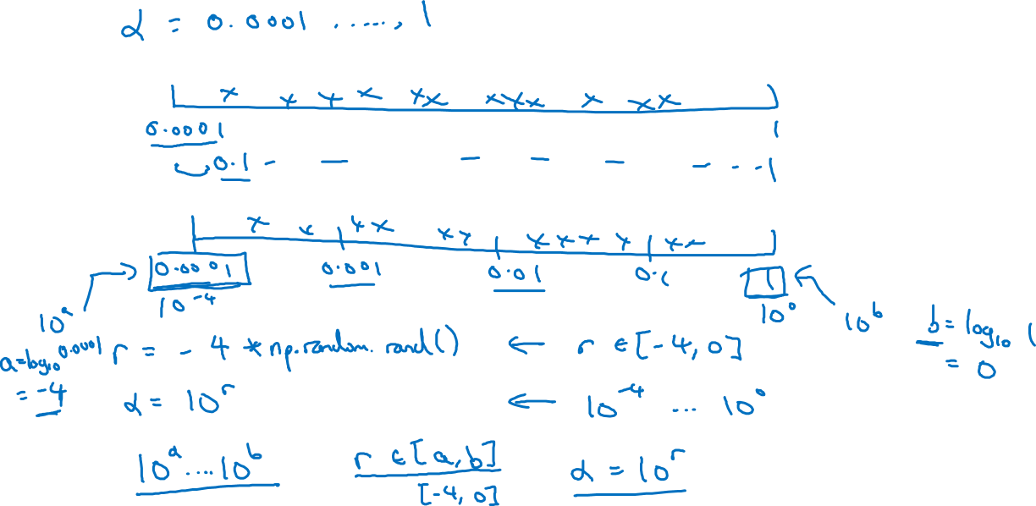
Appropriate scale for hyperparameters

Slide 8
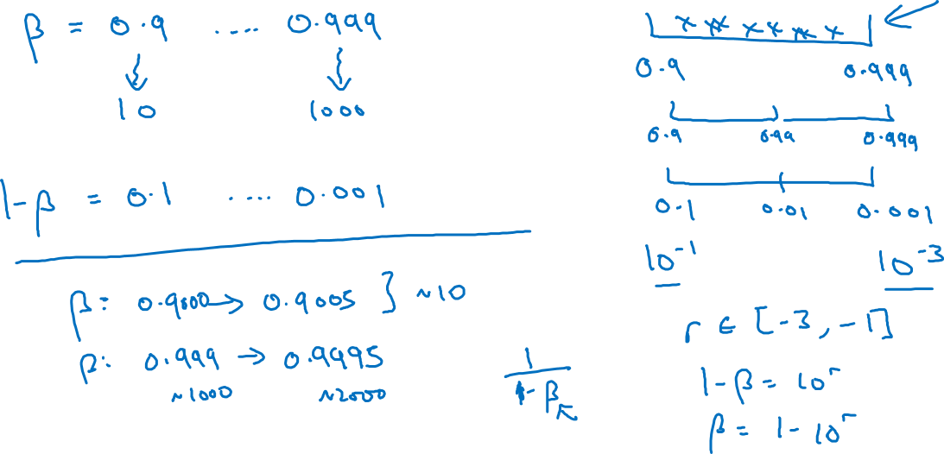
Hyperparameters for exponentially weighted averages

Slide 9
Hyperparameters tuning
Hyperparameters
tuning in practice:
Pandas vs. Caviar
deeplearning.ai

Slide 10


Re-test hyperparameters occasionally
Idea
NLP, Vision, Speech,
Ads, logistics, ….
Intuitions do get stale. Re-evaluate occasionally.
Experiment
Code

Slide 11
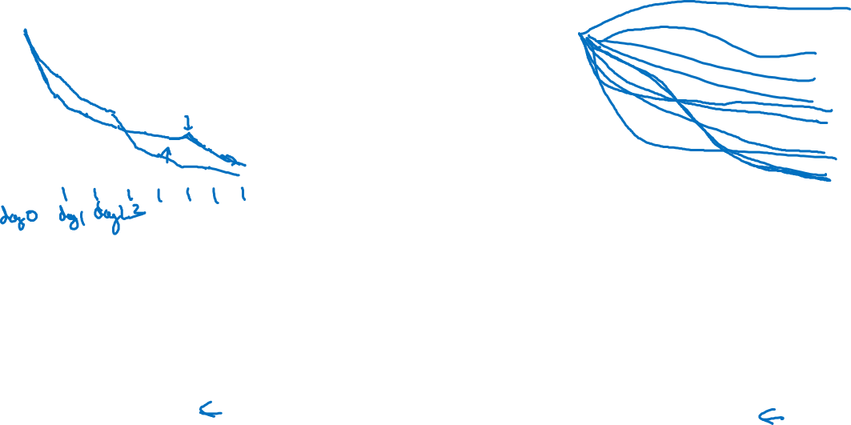
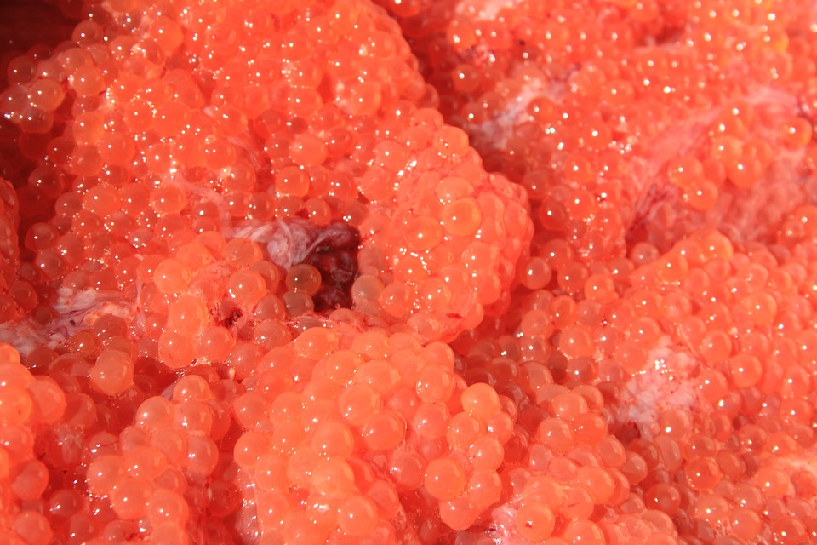
Babysitting one model
Training many models in parallel
Panda
Caviar

Slide 12
Batch Normalization
Normalizing activations
in a network
deeplearning.ai

Slide 13
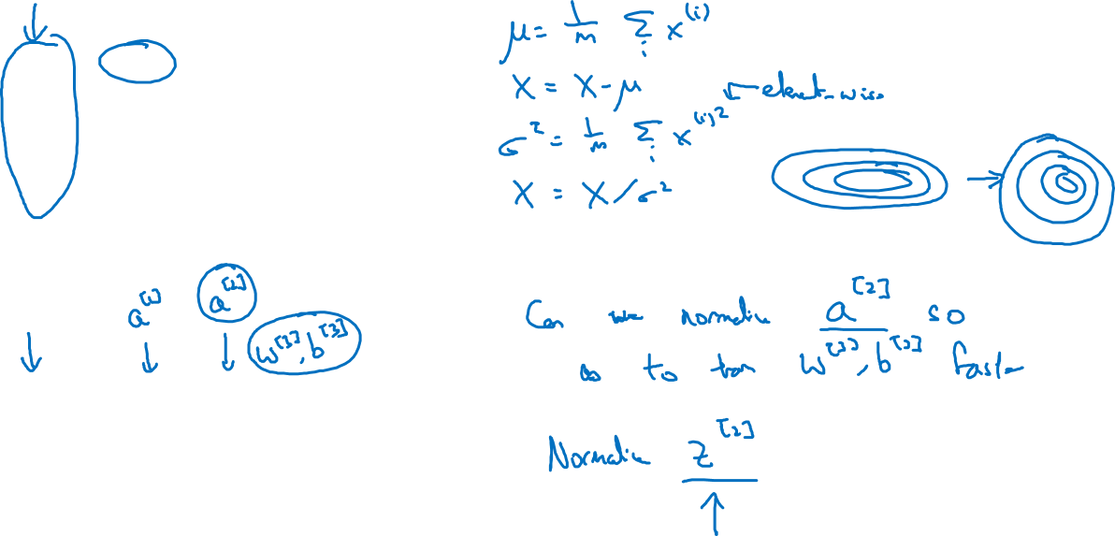









Normalizing inputs to speed up learning

Slide 14
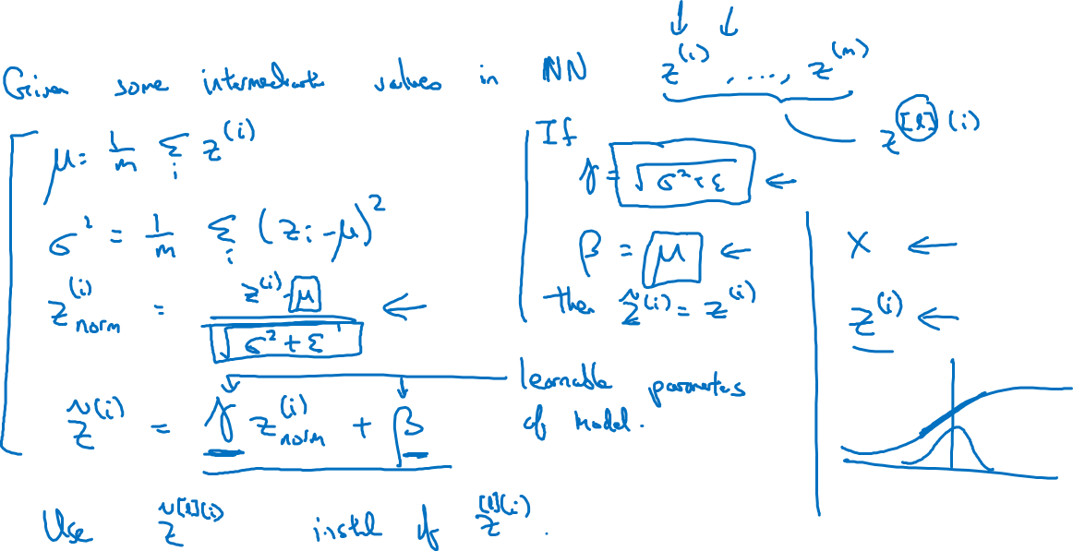
Implementing Batch Norm

Slide 15
Batch Normalization
Fitting Batch Norm
into a neural network
deeplearning.ai

Slide 16
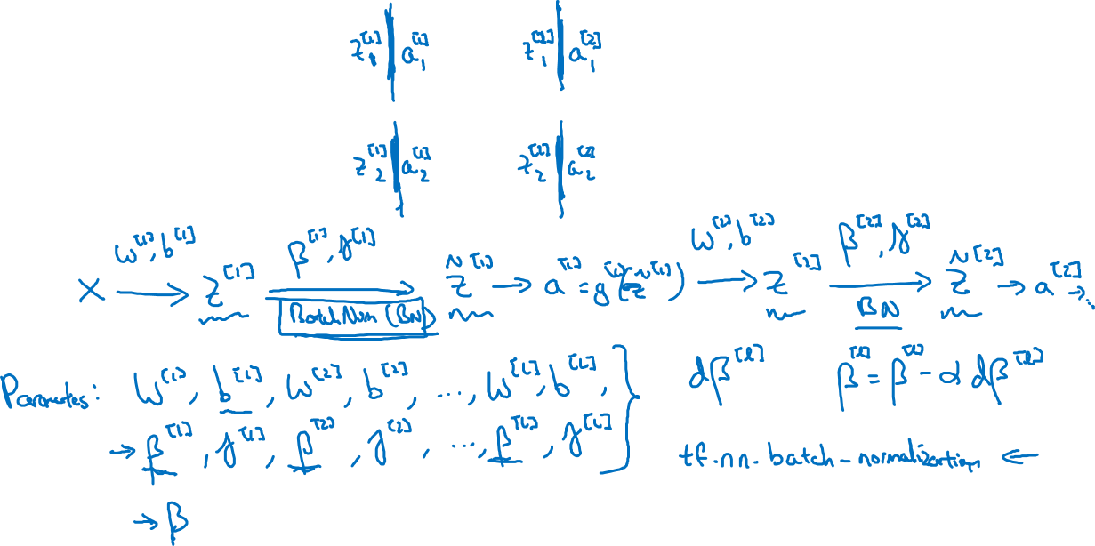




Adding Batch Norm to a network

Slide 17
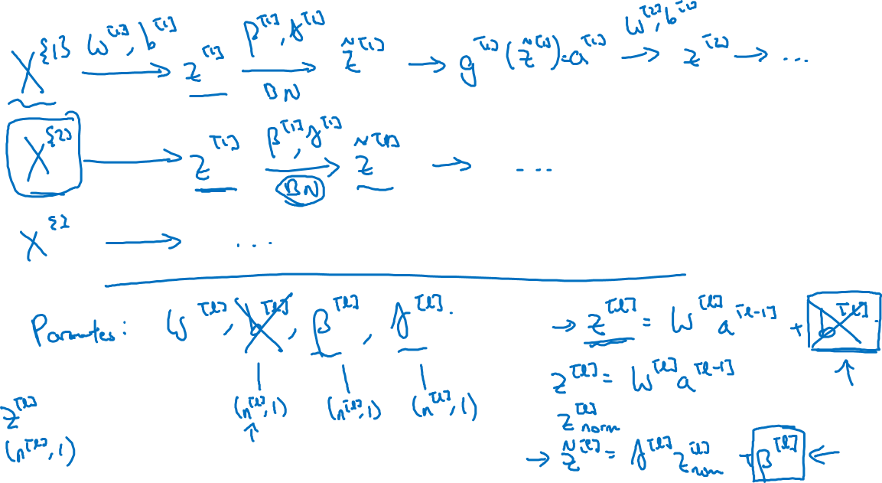
Working with mini-batches

Slide 18
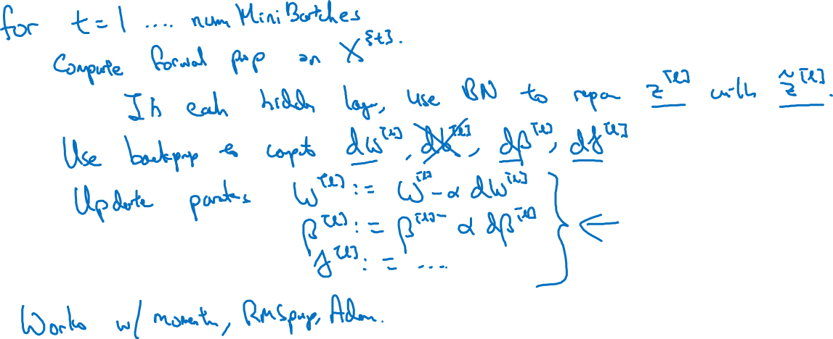
Implementing gradient descent

Slide 19
Batch Normalization
Why does
Batch Norm work?
deeplearning.ai

Slide 20
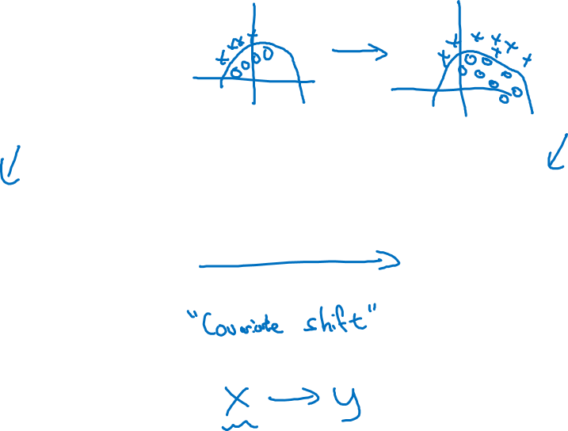
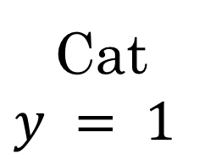
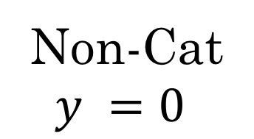



Learning on shifting input distribution
Cat
Non-Cat

Slide 21
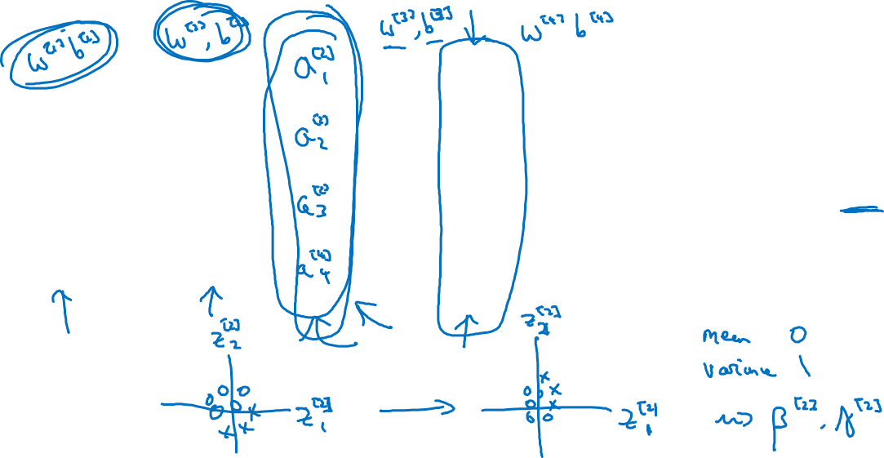




Why this is a problem with neural networks?

Slide 22
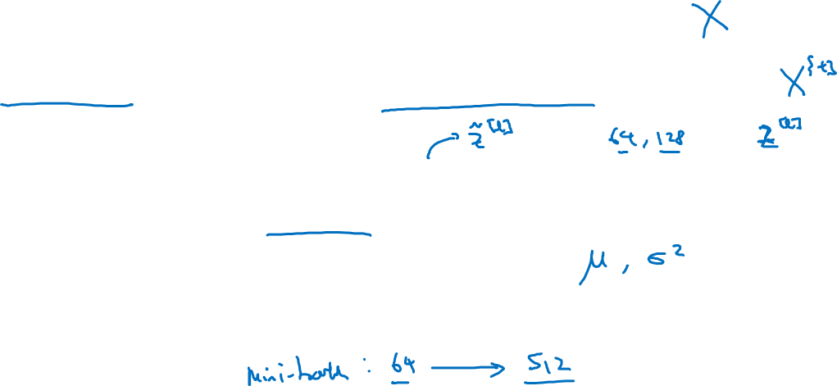
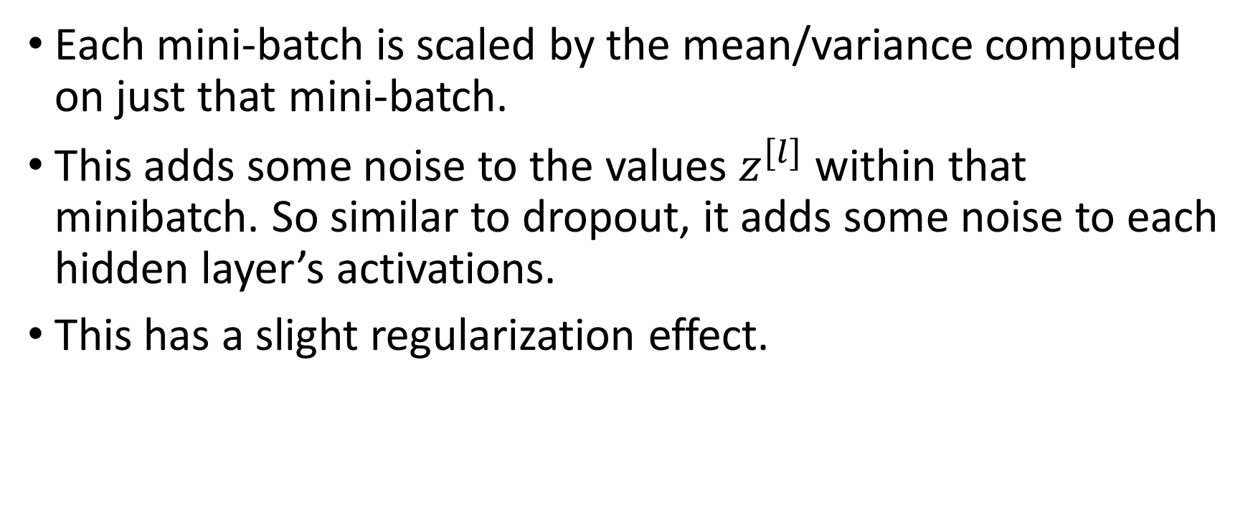
Batch Norm as regularization
Each mini-batch is scaled by the mean/variance computed on just that mini-batch.
This adds some noise to the values within that minibatch. So similar to dropout, it adds some noise to each hidden layer’s activations.
This has a slight regularization effect.

Slide 23
Batch Normalization
Batch Norm at
test time
deeplearning.ai

Slide 24
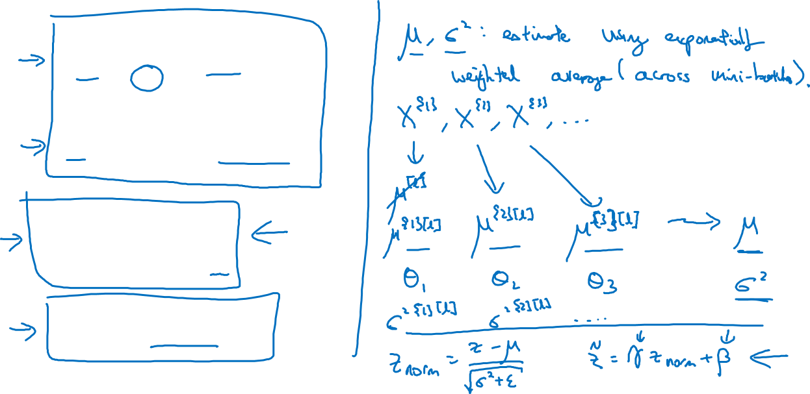
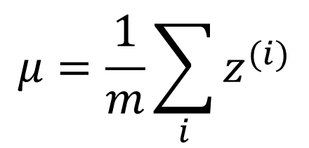
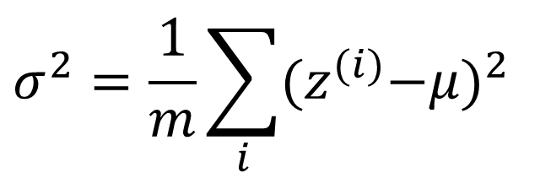
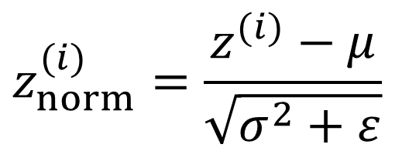
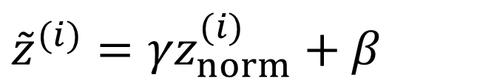
Batch Norm at test time

Slide 25
Multi-class classification
Softmax regression
deeplearning.ai

Slide 26

Recognizing cats, dogs, and baby chicks
3
1
2
0
3
2
0
1
X

Slide 27

Softmax layer
X

Slide 28
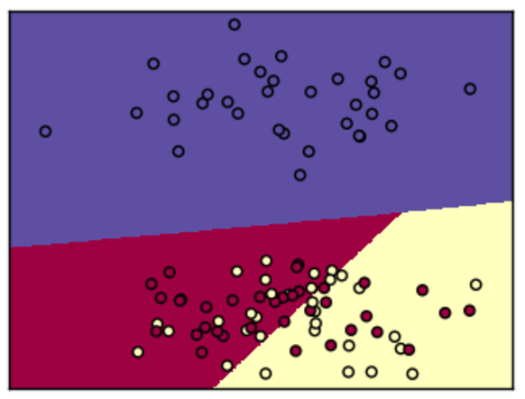
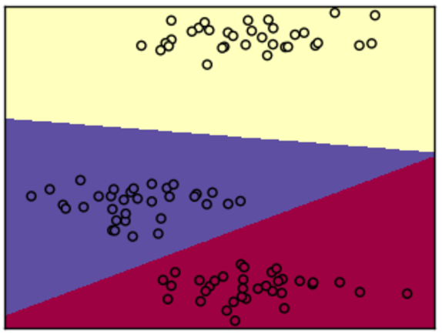
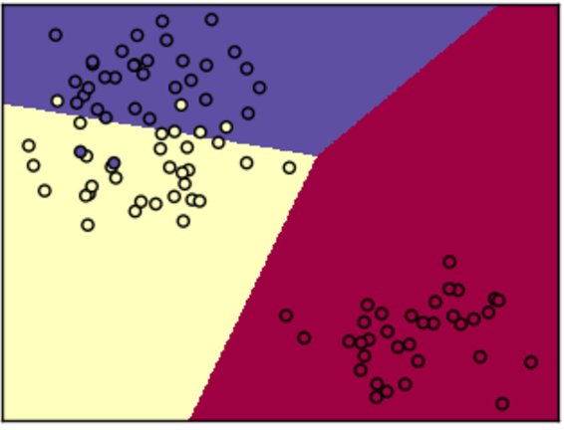
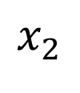
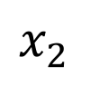
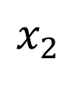



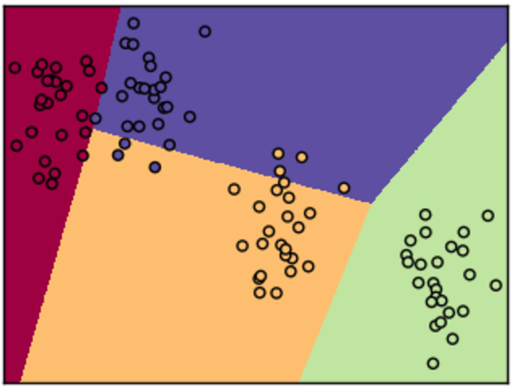
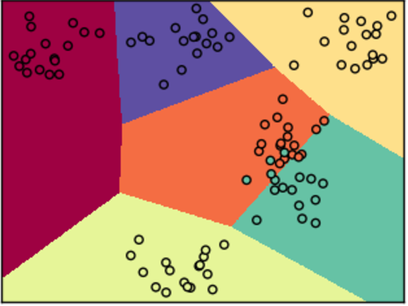
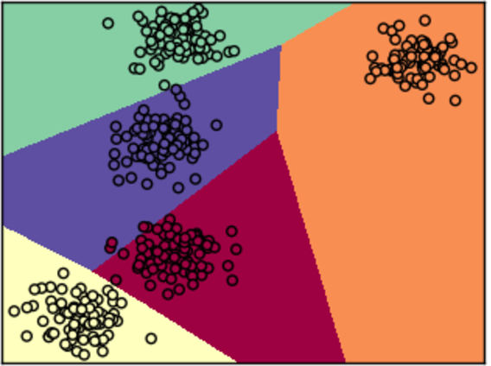
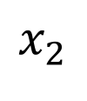
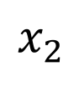
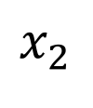



Softmax examples

Slide 29
Multi-class classification
Trying a softmax
classifier
deeplearning.ai

Slide 30
Understanding softmax

Slide 31
Loss function

Slide 32
Summary of softmax classifier
X

Slide 33
Programming Frameworks
Deep Learning frameworks
deeplearning.ai

Slide 34
Deep learning frameworks
Choosing deep learning frameworks
Ease of programming (development and deployment)
Running speed
Truly open (open source with good governance)
Caffe/Caffe2
CNTK
DL4J
Keras
Lasagne
mxnet
PaddlePaddle
TensorFlow
Theano
Torch

Slide 35
Programming Frameworks
TensorFlow
deeplearning.ai

Slide 36
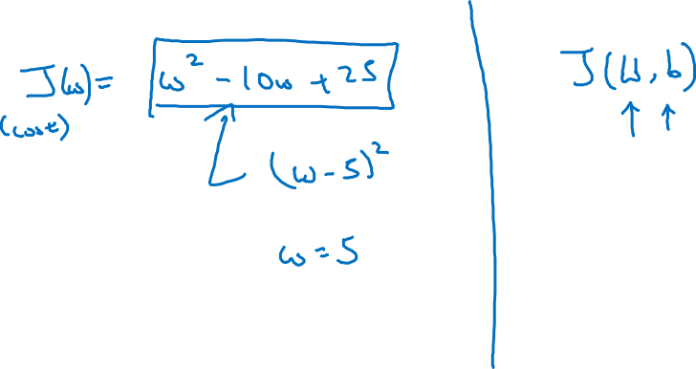
Motivating problem

Slide 37
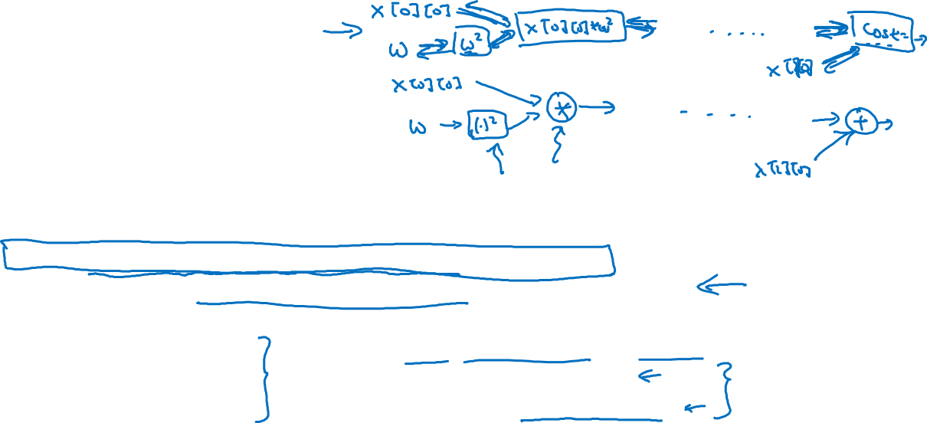
Code example
import numpy as np
import tensorflow as tf
coefficients = np.array([[1], [-20], [25]])
w = tf.Variable([0],dtype=tf.float32)
x = tf.placeholder(tf.float32, [3,1])
cost = x[0][0]*w**2 + x[1][0]*w + x[2][0] # (w-5)**2
train = tf.train.GradientDescentOptimizer(0.01).minimize(cost)
init = tf.global_variables_initializer()
session = tf.Session()
session.run(init)
print(session.run(w))
for i in range(1000):
session.run(train, feed_dict={x:coefficients})
print(session.run(w))
with tf.Session() as session:
session.run(init)
print(session.run(w))

